Slide 1
Waves Science as a human endeavour

Slide 2
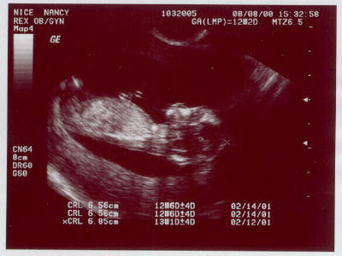
Medical applications
Ultrasonic scanning, also known as ultrasonography uses high frequency sound waves to produce images on a screen.
It is quicker, easier and cheaper than other scans, such as MRI.
Often used to monitor and diagnose conditions of organs and muscles, which are hard to detect with x-rays.

Slide 3
Ultrasound- How does it work?
The ultrasound machine transmits high frequency (1 to 15 MHz) sound pulses into a body.
When these waves hit a boundary between tissues, some are reflected back to the probe, and some are transmitted.
Of the transmitted waves, some will get reflected at the next boundary and so on.
The reflected waves are picked up by the machine and plotted based on return time of the sound, and the speed of sound in tissue (about 1540m/s). This plot forms a 2-dimensional image.

Slide 4
Ultrasound
Why do ultrasounds use high frequencies?
This is because high frequencies have shorter wavelengths. These are absorbed more easily, and are not as penetrating.
Low frequencies can be used for deeper imaging.

Slide 5
2.5 MHz: deep abdomen, obstetric and gynaecological imaging
3.5 MHz: general abdomen, obstetric and gynaecological imaging
5.0 MHz: vascular, breast, pelvic imaging
7.5 MHz: breast, thyroid
10.0 MHz: breast, thyroid, superficial veins, superficial masses, musculoskeletal imaging.
15.0 MHz: superficial structures, musculoskeletal imaging.

Slide 6
Geophysical exploration
Seismology is a branch of science that studies earthquakes.
This study looks at earthquakes, and how they behave and reflect to determine properties of the Earth that we cannot directly observe, such as the subsurface.

Slide 7
P-waves
P-waves, also called Primary waves or pressure waves.
These waves move longitudinally.
These waves can penetrate Earths crust, and can be detected far from

Slide 8
S-Waves
S-waves, also caller shear waves or secondary waves.
These move as a shear, or transverse wave.
These cannot penetrate Earth’s core.

Slide 9
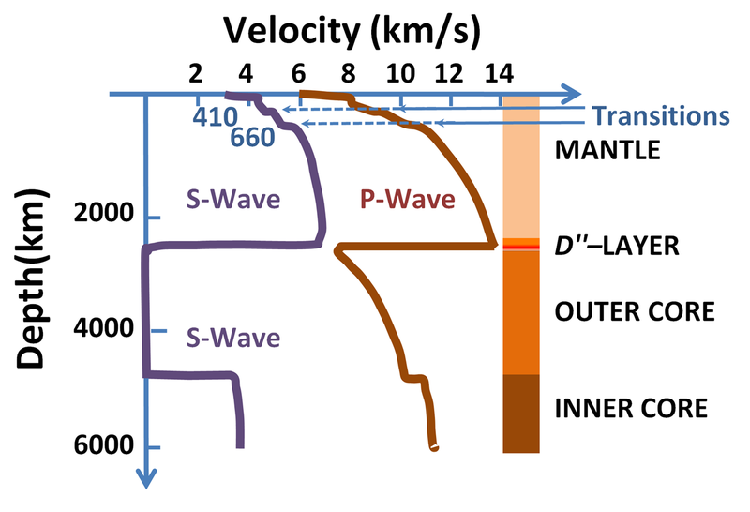
Seismology
By studying these waves, their difference in arrival time and whether or not they do arrive at certain points on the surface allow scientists to probe the inner structure of the Earth.
Help to determine that the Earth has both liquid and solid layers, their sizes and what they are made of.

Slide 10
Noise pollution
Disturbing noise with harmful impacts on human or animal life.
Can have both psychological damage and physical
Psychological - Stress
- Sleep disturbances
- Reduced concentration

Slide 11
Noise Pollution
Physical damage from noise pollution
- Hypertension (HBP)
- Heart attacks
- Hearing loss
- Tinnitus

Slide 12

Acoustic Engineering
Noise Control.
Both reduction of unwanted noise and amplification or wanted noise.
For reduction- absorbs sound waves or designs structures so that reflection and amplification do not occur.

Slide 13
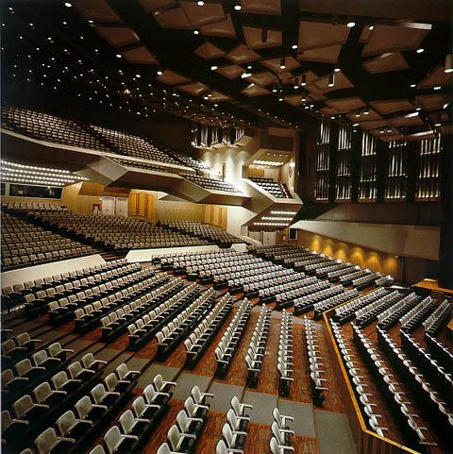
Acoustic Engineering
Not just reducing unwanted noise.
Ensuring wanted noises are not disrupted.
Concert halls, festivals, rooms, auditoriums, etc.
Do not want destructive interference of waves, echoes, unreasonable loud spots.

Slide 14


